Slide 1
DATABASE ENVIRONMENT
Course : ISYS6280 – Database Systems (GAT)
Year : 2017
Session 1

Slide 2
LEARNING OUTCOME
LO 1 : Describe database systems, terminology, environment, and new concept of database

Slide 3
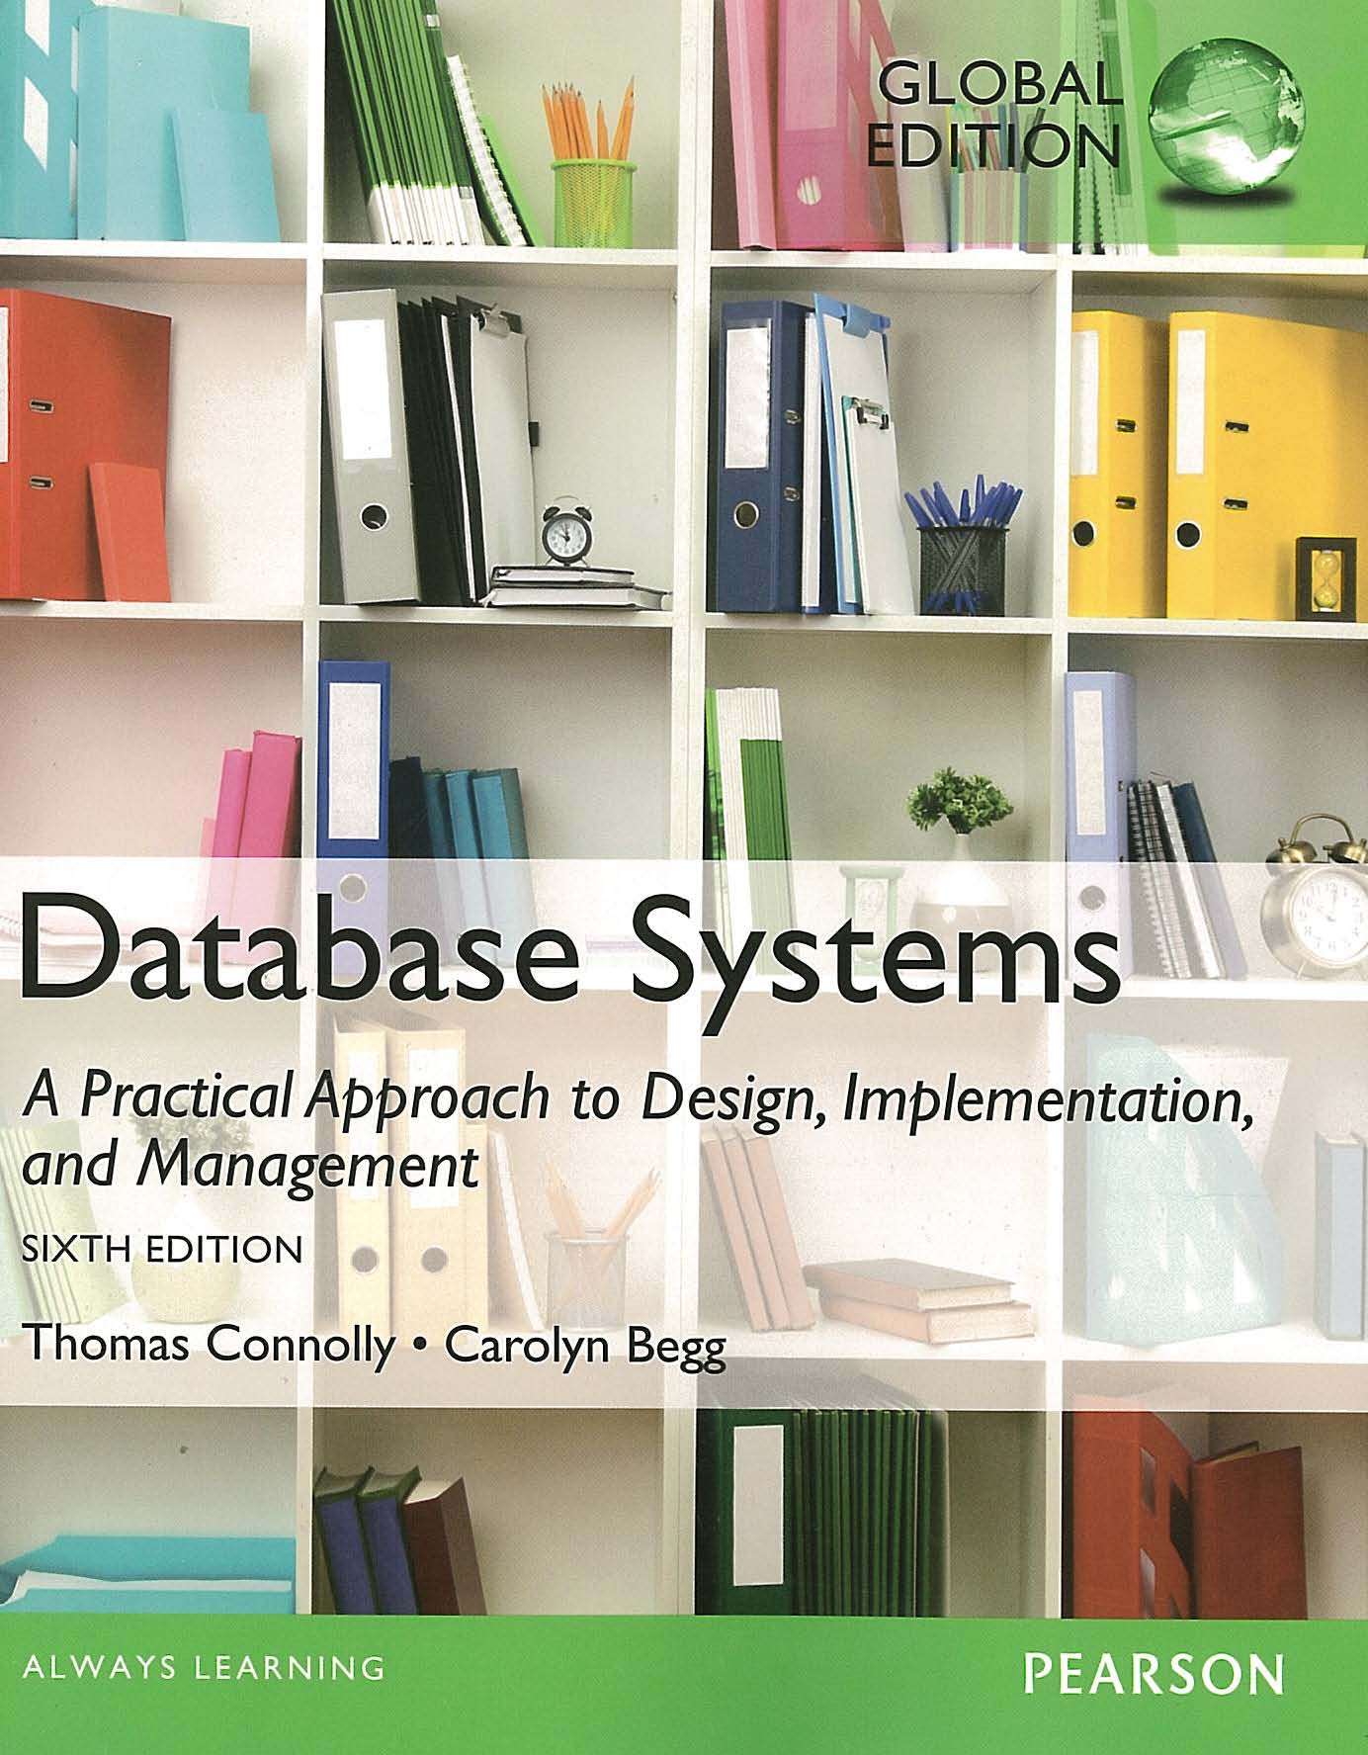
ACKNOWLEDGEMENT
These slides have been adapted from Thomas Connolly and Carolyn Begg. 2015. Database Systems: A Practical Approach To Design, Implementation, and Management. Pearson Education. USA. ISBN:978-1-292-06118-4

Slide 4
CHAPTER 2 DATABASE ENVIRONMENT

Slide 5
LEARNING OBJECTIVES
Purpose of three-level database architecture.
Contents of external, conceptual, and internal levels.
Purpose of external/conceptual and conceptual/internal mappings.
Meaning of logical and physical data independence.
Distinction between DDL and DML.
A classification of data models.

Slide 6
LEARNING OBJECTIVES
Purpose/importance of conceptual modeling.
Typical functions and services a DBMS should provide.
Function and importance of system catalog.
Software components of a DBMS.

Slide 7
Objectives of Three-Level Database Architecture
All users should be able to access same data.
A user’s view is immune to changes made in other views.
Users should not need to know physical database storage details.
DBA should be able to change database storage structures without affecting the users’ views.
Internal structure of database should be unaffected by changes to physical aspects of storage.
DBA should be able to change conceptual structure of database without affecting all users.

Slide 8
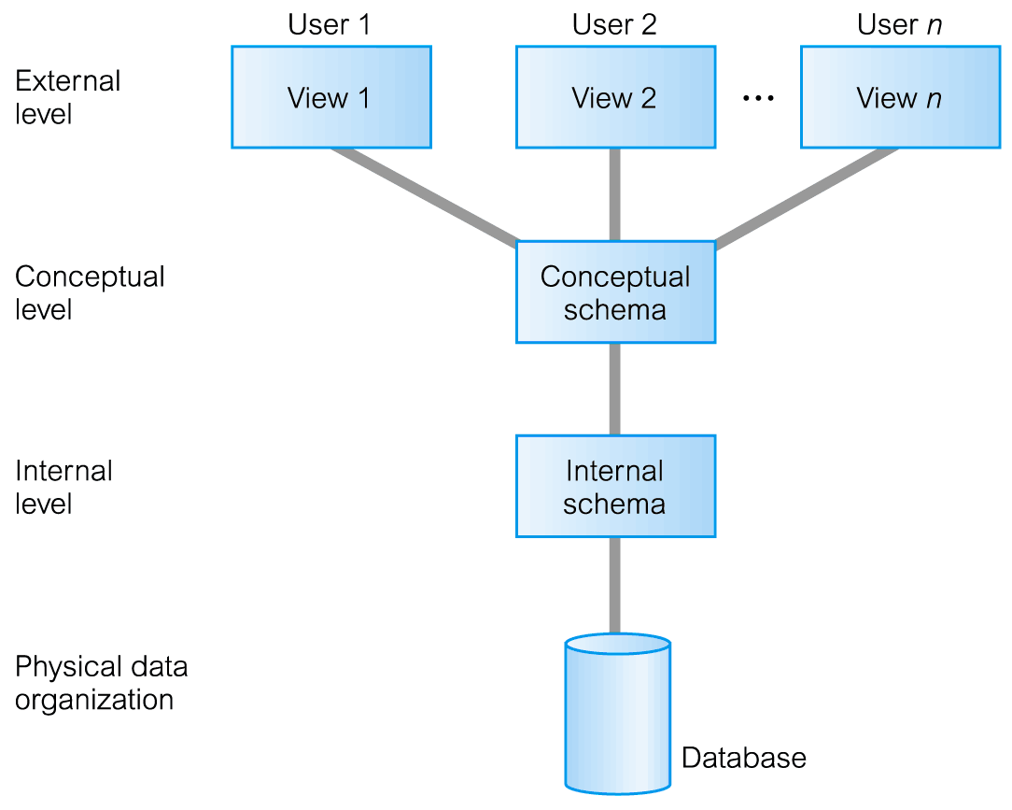
Three-Level Database Architecture
The ANSI-SPARC Three Level Architecture

Slide 9
ANSI-SPARC Three-Level Architecture
External Level
Users’ view of the database.
Describes that part of database that is relevant to a particular user.
Conceptual Level
Community view of the database.
Describes what data is stored in database and relationships among the data.
Internal Level
Physical representation of the database on the computer.
Describes how the data is stored in the database.

Slide 10
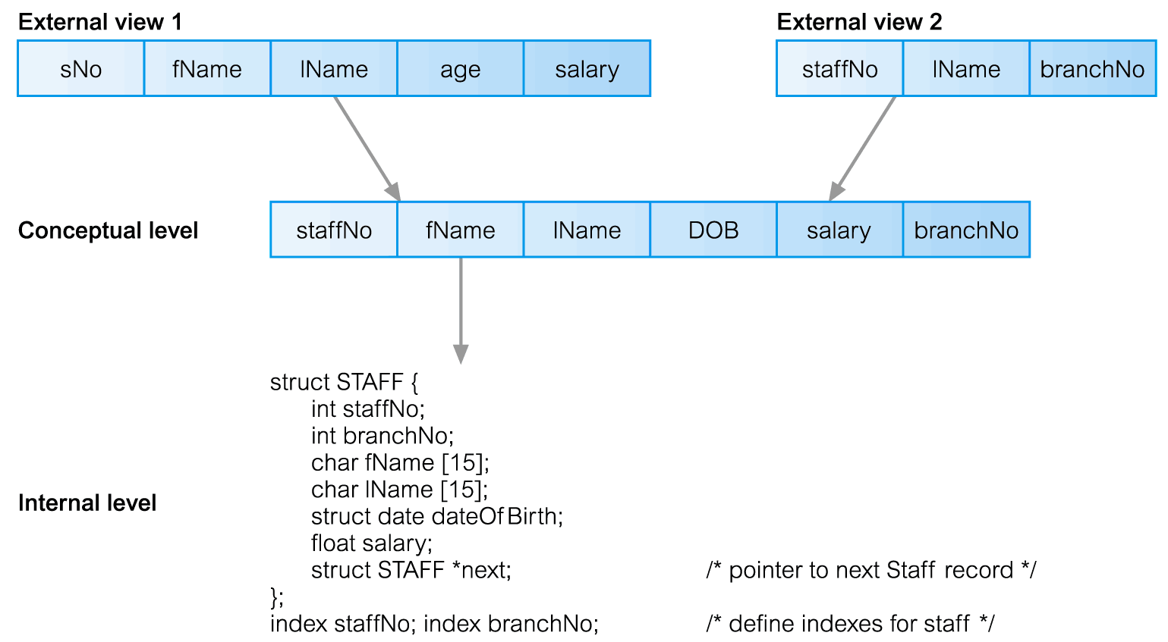
Differences between Three Levels of ANSI-SPARC Architecture

Slide 11
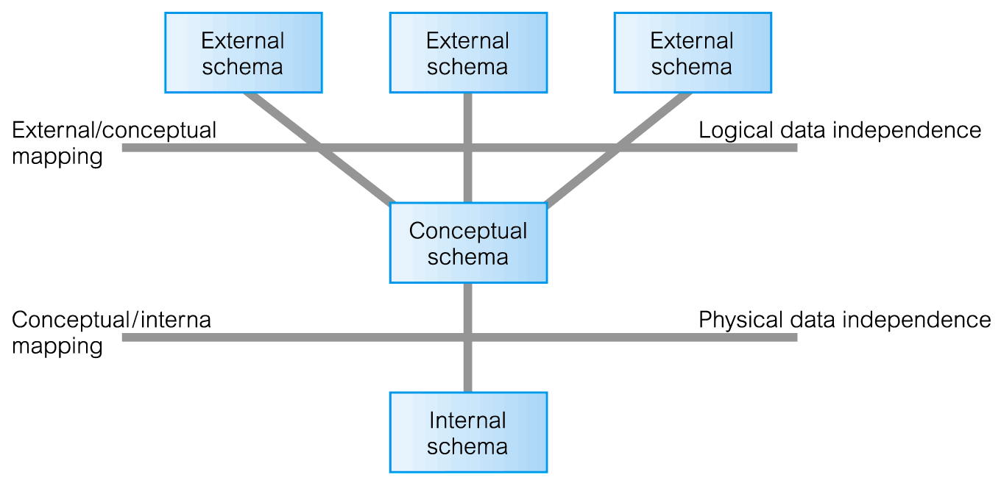
Data Independence and the ANSI-SPARC Three-Level Architecture

Slide 12
Data Independence
Logical Data Independence
Refers to immunity of external schemas to changes in conceptual schema.
Conceptual schema changes (e.g. addition/removal of entities).
Should not require changes to external schema or rewrites of application programs.
Physical Data Independence
Refers to immunity of conceptual schema to changes in the internal schema.
Internal schema changes (e.g. using different file organizations, storage structures/devices).
Should not require change to conceptual or external schemas.

Slide 13
Database Languages
Data Definition Language (DDL)
Allows the DBA or user to describe and name entities, attributes, and relationships required for the application
plus any associated integrity and security constraints.
CREATE, ALTER, DROP
Data Manipulation Language (DML)
Provides basic data manipulation operations on data held in the database.
INSERT, UPDATE, DELETE, SELECT
Data Control Language (DCL)
Manages user access
GRANT, REVOKE

Slide 14
Database Languages
Procedural DML
allows user to tell system exactly how to manipulate data.
For example: Relational Algebra
Non-Procedural DML
allows user to state what data is needed rather than how it is to be retrieved.
For example: Relational Calculus
Fourth Generation Languages (4GLs)

Slide 15

Data Model
Integrated collection of concepts for describing data, relationships between data, and constraints on the data in an organization.
Data Model comprises:
a structural part;
a manipulative part;
possibly a set of integrity rules.
www.tibco.com

Slide 16
Data Model
Purpose → To represent data in an understandable way.
Categories of data models include:
Object-Based Data Models
Entity-Relationship
Semantic
Functional
Object-Oriented.
Record-Based Data Models
Relational Data Model
Network Data Model
Hierarchical Data Model.
Physical Data Models

Slide 17
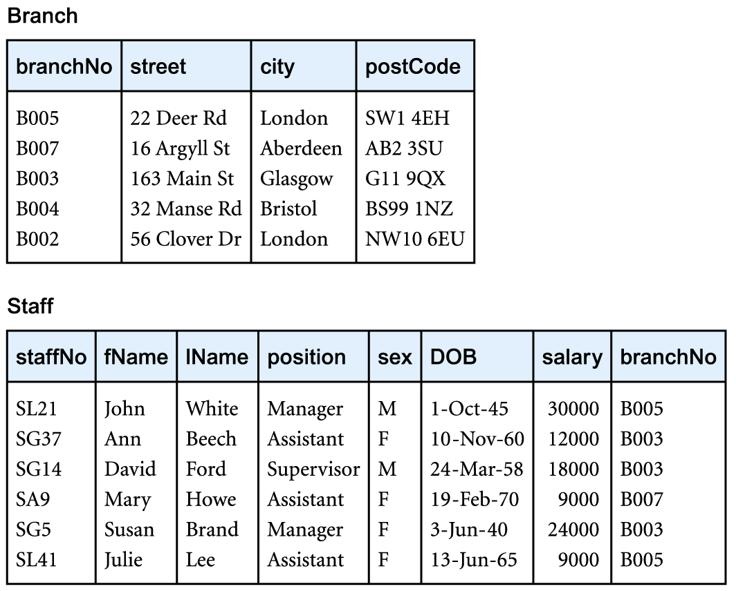
Relational Data Model

Slide 18
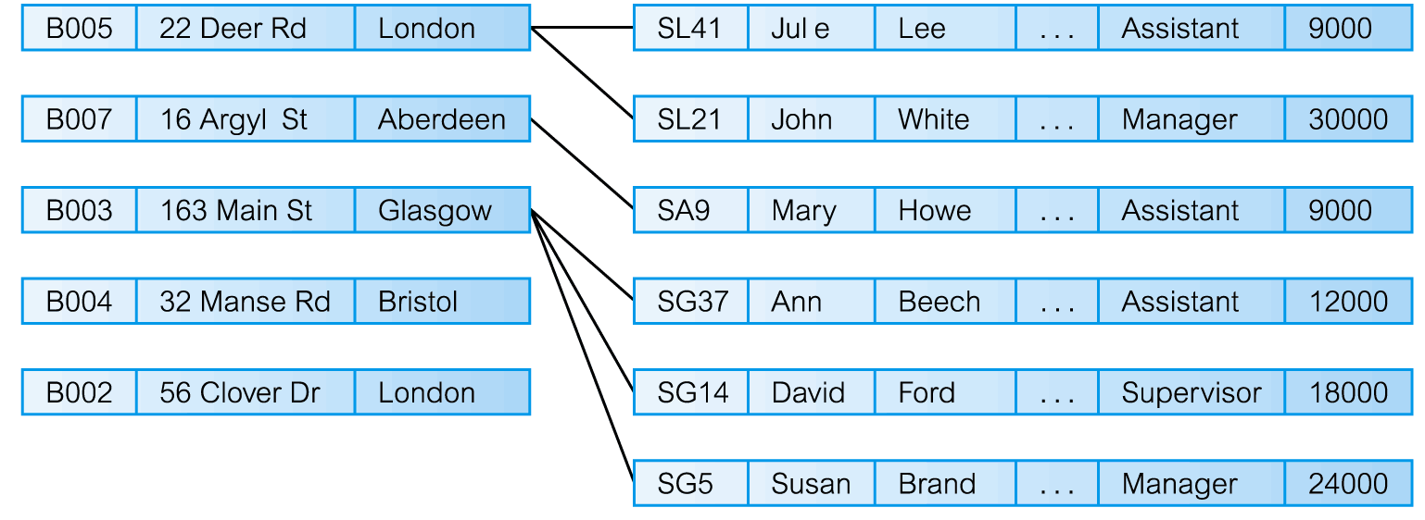
Network Data Model

Slide 19
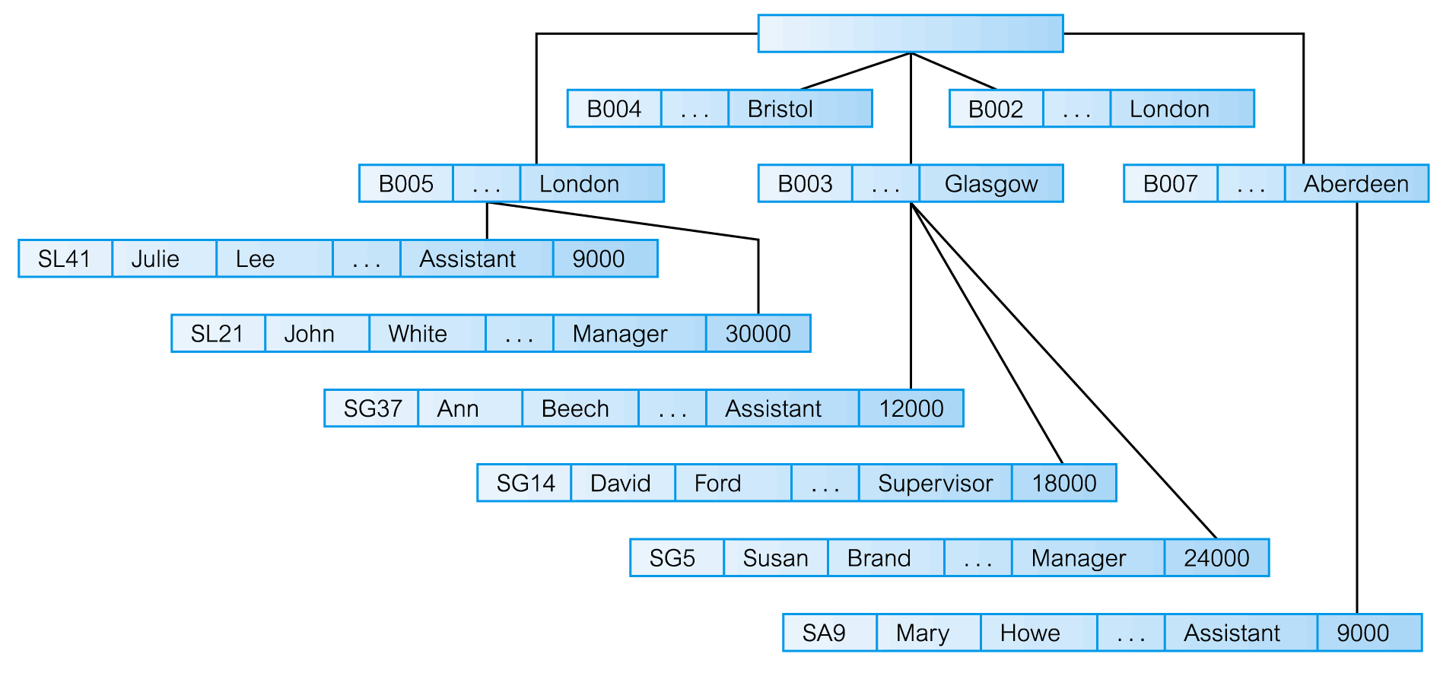
Hierarchical Data Model

Slide 20

Conceptual Modeling
Conceptual schema is the core of a system supporting all user views.
Should be complete and accurate representation of an organization’s data requirements.
Conceptual modeling is process of developing a model of information use that is independent of implementation details.
Result is a conceptual data model.
www.businessblogshub.com

Slide 21
Functions of a DBMS
Data Storage, Retrieval, and Update.
A User-Accessible Catalog.
Transaction Support.
Concurrency Control Services.
Recovery Services.
Authorization Services.
Support for Data Communication.
Integrity Services.
Services to Promote Data Independence.
Utility Services.

Slide 22
System Catalog
Repository of information (metadata) describing the data in the database.
One of the fundamental components of DBMS.
Typically stores:
names, types, and sizes of data items;
constraints on the data;
names of authorized users;
data items accessible by a user and the type of access;
usage statistics.

Slide 23
Components of a DBMS
Major components of a DBMS:
Query processor
Database manager (DM)
File manager
DML preprocessor
DDL compiler
Catalog manager

Slide 24
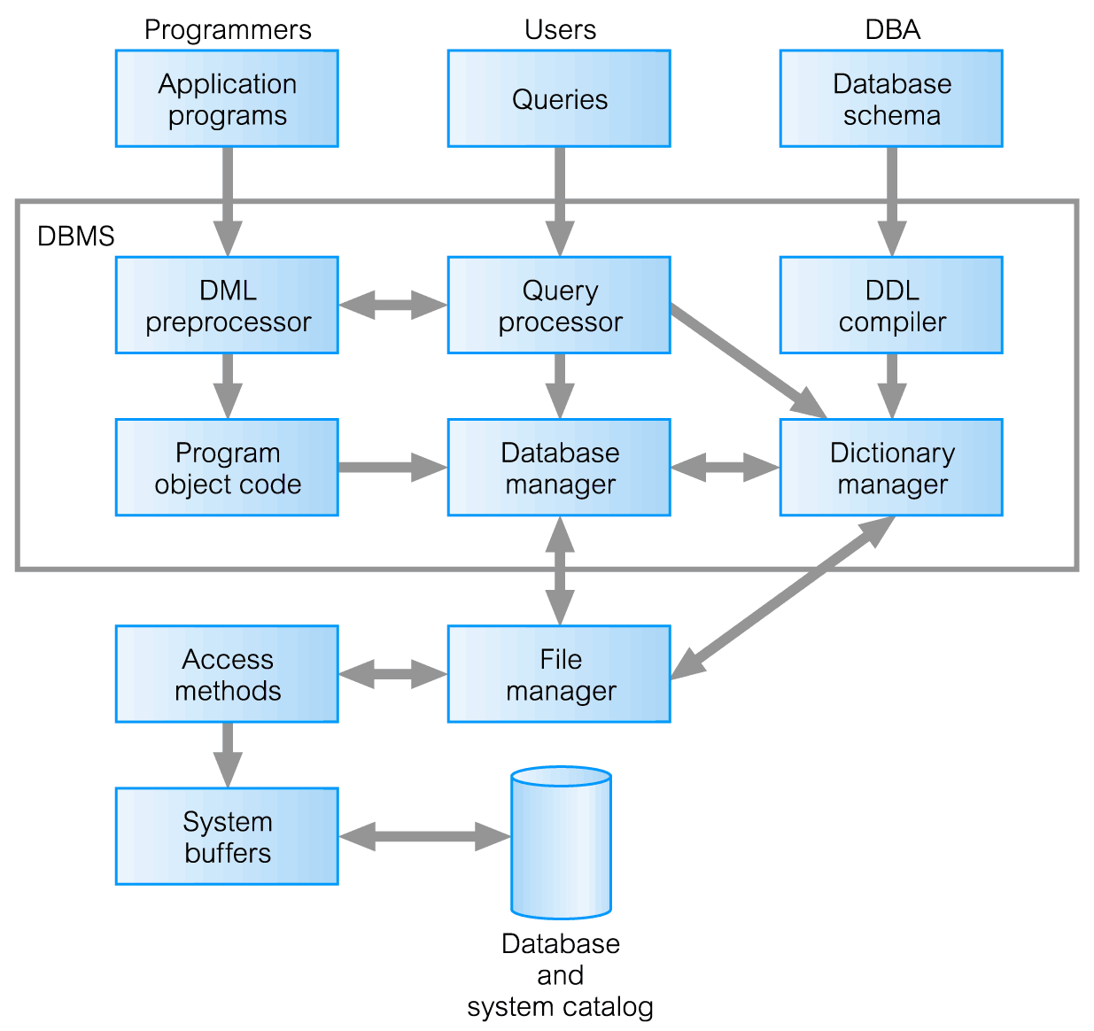
Components of a DBMS

Slide 25
Components of Database Manager (DM)
Major software components for database manager
Authorization control
Command processor
Integrity checker
Query optimizer
Transaction manager
Scheduler
Recovery manager
Buffer manager

Slide 26
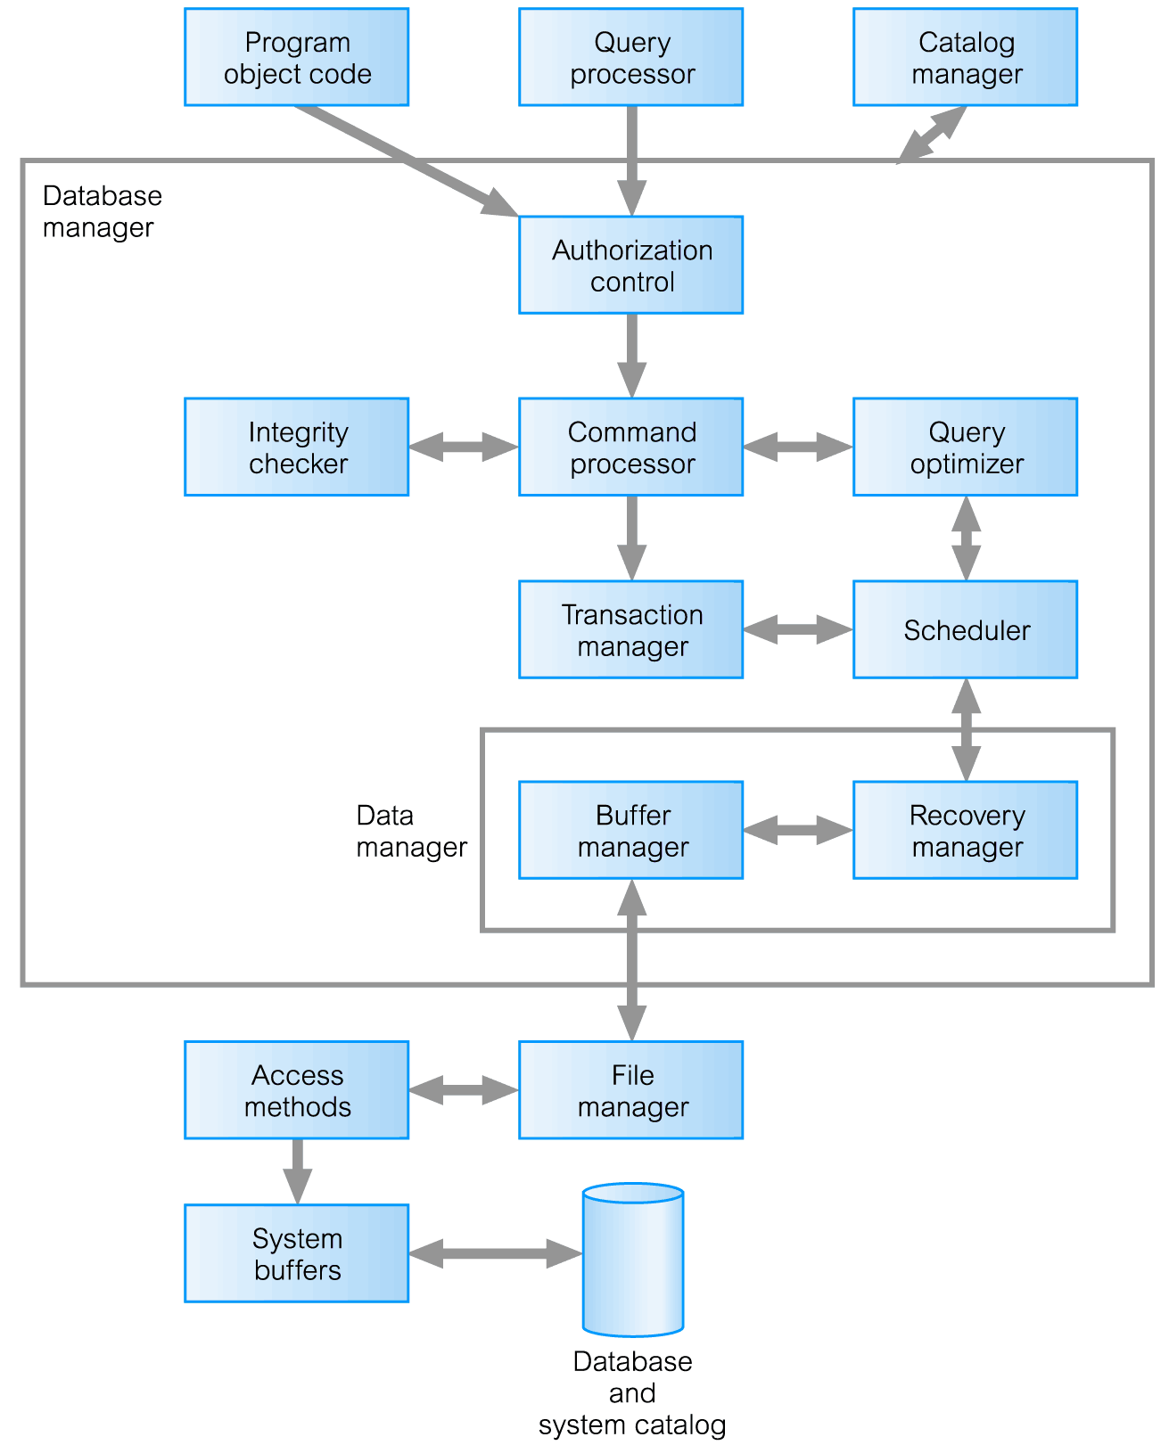
Components of Database Manager (DM)

Slide 27

www.healthytravelblog.com

